Slide 1


DSN2098 Project Exhibition-1
Review - 2

Slide 2
GROUP MEMBERS
20BCE10355 - Smitesh
20BCE10360 - Tejas Gawali
20BCE10843 - Aryan Singh
20BCE10798 - Khush Bubna
20BCE11049 - Areeb Ahmad Siddiqui

Slide 3
Problem Statement
Healthcare is the basic need of human being. The category of patients involves all human beings housewives, businessmen, students, teachers, service men and also all of them have a busy hectic schedule. Today’s life is full of responsibilities and stress. So, people are prone to diseases of different types and it is one’s own duty to make themselves fit and healthy.
In day to day life, it is difficult for one person to remind the other of their daily intake of medicines. In our developing and technology dependent life we totally rely on gadgets. With this, we get an opportunity to use technology in a better way so that it can be made useful to us. And it plays an important part in our daily life and helps us staying fit in many ways.

Slide 4

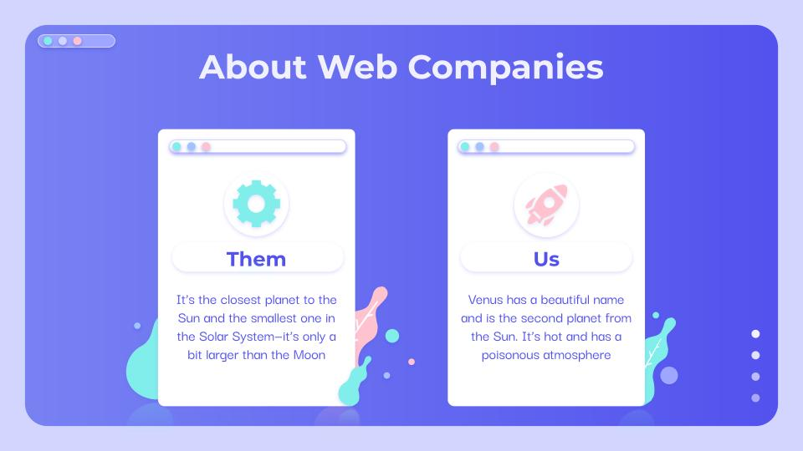
Objective
We are introducing an Web application named MEDBUDDY, whose objective is to remind the patients of their dosage timings so that they can stay fit and healthy. Through this they may remember which medicine is to be taken. This application focusses on the people who forget to take medicines on time.
The application is designed such that it can be helpful for busy people and old age people and even can spread health care awareness. It is life-saving, money saving and time-saving application which is easy to use and provides a good user interface.

Slide 5
Our goals
ACCURATE
USABILITY
THE APPLICATION WILL BE ACCURATE AND THE USER NEED NOT TO WORRY ABOUT REMEMBERING THE MEDICATION AT ALL
EASY TO USE
USER-INTERFACE TO BE USED BY ANYONE IN THE FAMILY

Slide 6
ARCHITECTURE
Healthcare Articles & Tips
Patient / Doctor Login
Patient
Medicine
Notification
And Alarm
Medicine
Reminder Application
Doctor Inputs Medicine Description
List Of Hospitals And Doctors

Slide 7
MODULE SPLIT-UP
MODULE 1
MODULE 2
08.
Basics of HTML; The tags-attributes-classes-ids-block-elements-inline elements, How the basic structure of website look.
Form this module we have used the html tags, forms labels etc to create the skeleton of our website
HTML
CSS
BOOTSTRAP
JAVA SCRIPT
Basics of Cascading Style Sheets (CSS); Container properties, colours-borders-alignment-fonts-forms-buttons; From this module we have used the prevalent styling features provided by the CSS to style the overall look of our website syncing it with the html page created already for a responsive display.

Slide 8
MODULE SPLIT-UP
MODULE 3
MODULE 4
Basics of JavaScript; data types, built-in methods, and variables. if, else statements, scoping objects ,functions
From this module we have used concepts like notification , DOM manipulation to inculcate the functions of our website
HTML
CSS
BOOTSTRAP
JAVA SCRIPT
Basics of Bootstrap; Built-in Support ,functions, CSS, components ,jQuery plug-ins etc.
In this module we shall use the functions of bootstrap to modify the websites and make it more functional

Slide 9
DEMO

Slide 10
References
https://developer.mozilla.org/en-US/docs/Web/API/notification
https://developer.mozilla.org/en-US/docs/Web/API/Window/localStorage
https://developer.mozilla.org/en-US/docs/Web/API/Document_Object_Model/Introduction
https://developer.mozilla.org/en-US/docs/Learn/JavaScript/Objects/JSON
https://getbootstrap.com/docs/5.1/components
https://www.w3schools.com/

Slide 11
THANK YOU

